Slide 1
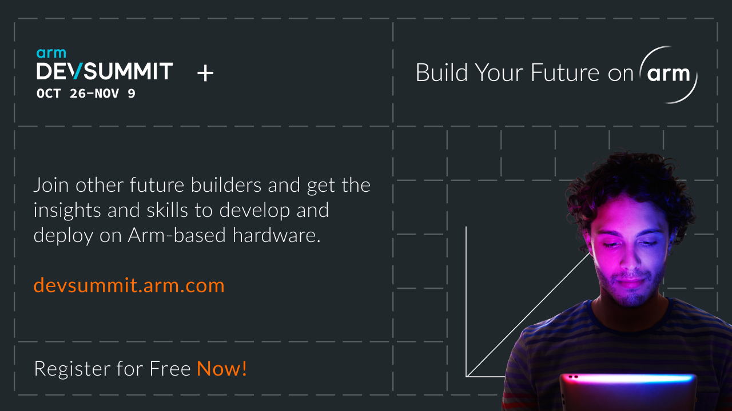
Partner Logo
Notes:
The event features masterclasses, hands-on workshops, keynotes, and networking opportunities for software developer. You can attend free and online!

